Slide 1
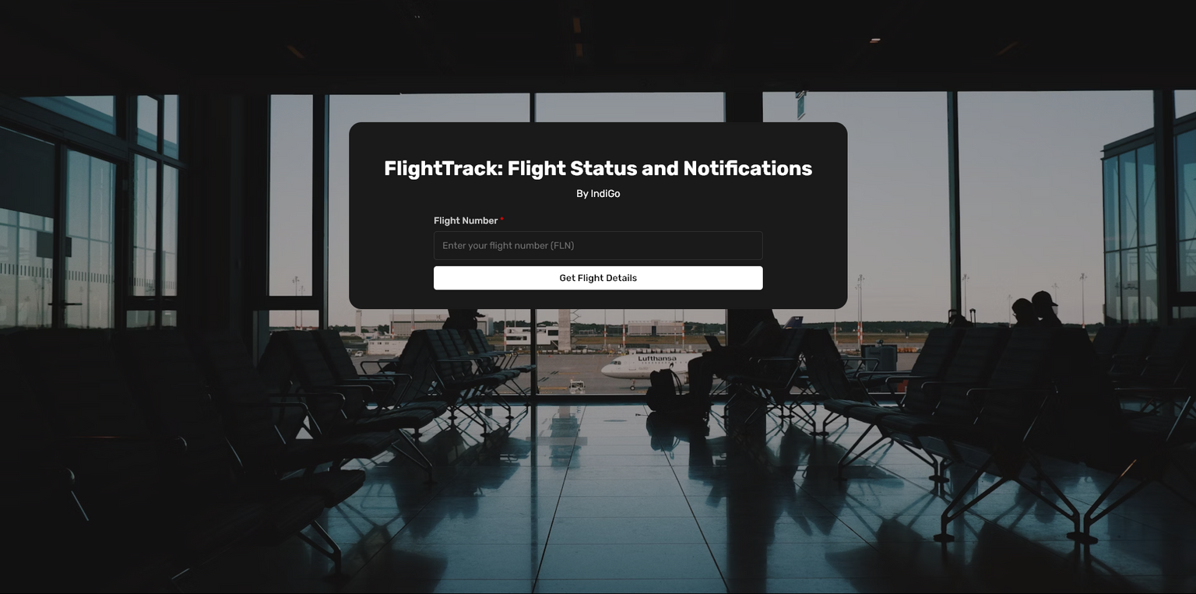


FlightTrack: Your Personal Flight Assistant
Stay informed with real-time updates on the flight status and notifications with FlightTrack. Stay connected to receive timely notifications and access detailed flight information conveniently.
Indigo - Hack to Hire 2024
By-
Name: Lakshay Chauhan
Email: lakshaychauhan030@gmail.com
Date: 29/07/2024

Slide 2
PROBLEM STATEMENT
Analysis of problem statement with issues and their solutions
01
02
03
04
05
REAL-TIME UPDATES
PUSH NOTIFICATIONS
INTEGRATION WITH AIRPORT SYSTEMS
USER EXPERIENCE
DATA SECURITY AND PRIVACY
Issues
Passengers often face uncertainty regarding flight status, leading to anxiety and potential inconvenience.
Passengers may miss critical updates if they rely solely on manual checks for flight information.
Accurate flight information can be challenging to obtain without direct integration with airport databases.
Users need a seamless and intuitive interface to easily access flight information and set up notifications.
Handling sensitive user information such as email addresses and phone numbers requires robust security measures to protect data privacy.
Solutions
Implement a system that provides up-to-the-minute information on flight status, including delays, cancellations, and gate changes.
Send automated notifications via SMS, email, or app notifications to ensure passengers receive timely updates regardless of their current activity.
Establish connections with airport systems to pull real-time data, enhancing the accuracy and reliability of the information provided to passengers.
Develop a user-friendly frontend using modern web technologies like React.js, ensuring a smooth and intuitive user experience.
Implement strong data security practices, including secure data storage and transmission protocols, to safeguard user information and build trust.

Slide 3




INTRODUCTION AND KEY FEATURE DETAILS
REAL-TIME UPDATES
PUSH NOTIFICATIONS
Fetch and display live flight data including status, terminal, gate, and delays using Flightera API.
Enable notifications via email and SMS. Implement OTP verification for secure and spam-free user registrations.
FlightTrack is a comprehensive system designed to provide real-time flight tracking and notifications, ensuring passengers are always informed about their flight statuses.
The system leverages advanced technologies and integrates multiple services to deliver accurate and timely updates.
OTP VERIFICATION
INTEGRATION WITH FLIGHTERA API
Implement OTP verification to prevent spamming and ensure only genuine users subscribe for notifications.
Pull real-time flight data from Flightera API for accurate information.

Slide 4
TECH STACK
Full Stack Development
FlightTrack Tech Stack
Efficient Integration of Modern Technologies for Frontend, Backend, Database, services, and APIs
Frontend
Backend
Database
- React.js: Dynamic and responsive user interface.
- HTML & CSS: Structuring and styling the web application.
- Toastify: Provides user-friendly notifications.
APIs and Services
- Python & Flask: Server-side logic and API handling.
- Flask-CORS: Enables cross-origin requests.
- APScheduler: Regularly checks for flight updates.
- MongoDB: Stores user information and flight status.
- Flightera API: Fetches real-time flight data.
- Twilio: Sends SMS notifications.
- smtplib: Handles email notifications.

Slide 5
DIAGRAM FLOW
Brief Architecture for FlightTrack
User Input
Notification
User enters flight number on the frontend (React.js).
Flask sends SMS/email notifications to the user about flight status changes.
API Request
OTP Generation/Verification
React.js sends an API request to Flask backend.
Flask generates and verifies OTP using Twilio/smtplib.
Backend Processing
Data Retrieval
Data Storage
Flask processes the request, interacts with MongoDB, and makes API calls to Flightera.
Flightera API returns flight data to Flask.
Flask stores user and flight information in MongoDB.

Slide 6
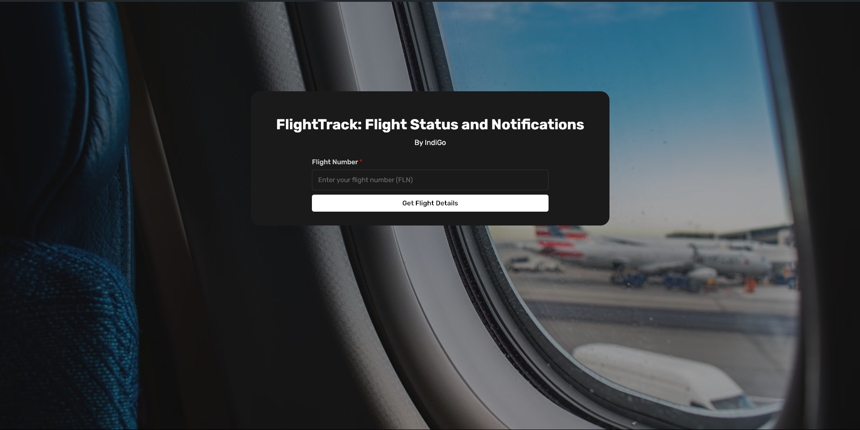
FLIGHTTRACK SCREENSHOTS
1. LANDING PAGE
The landing page where users can enter their flight number to track flight status and subscribe for notifications.

Slide 7
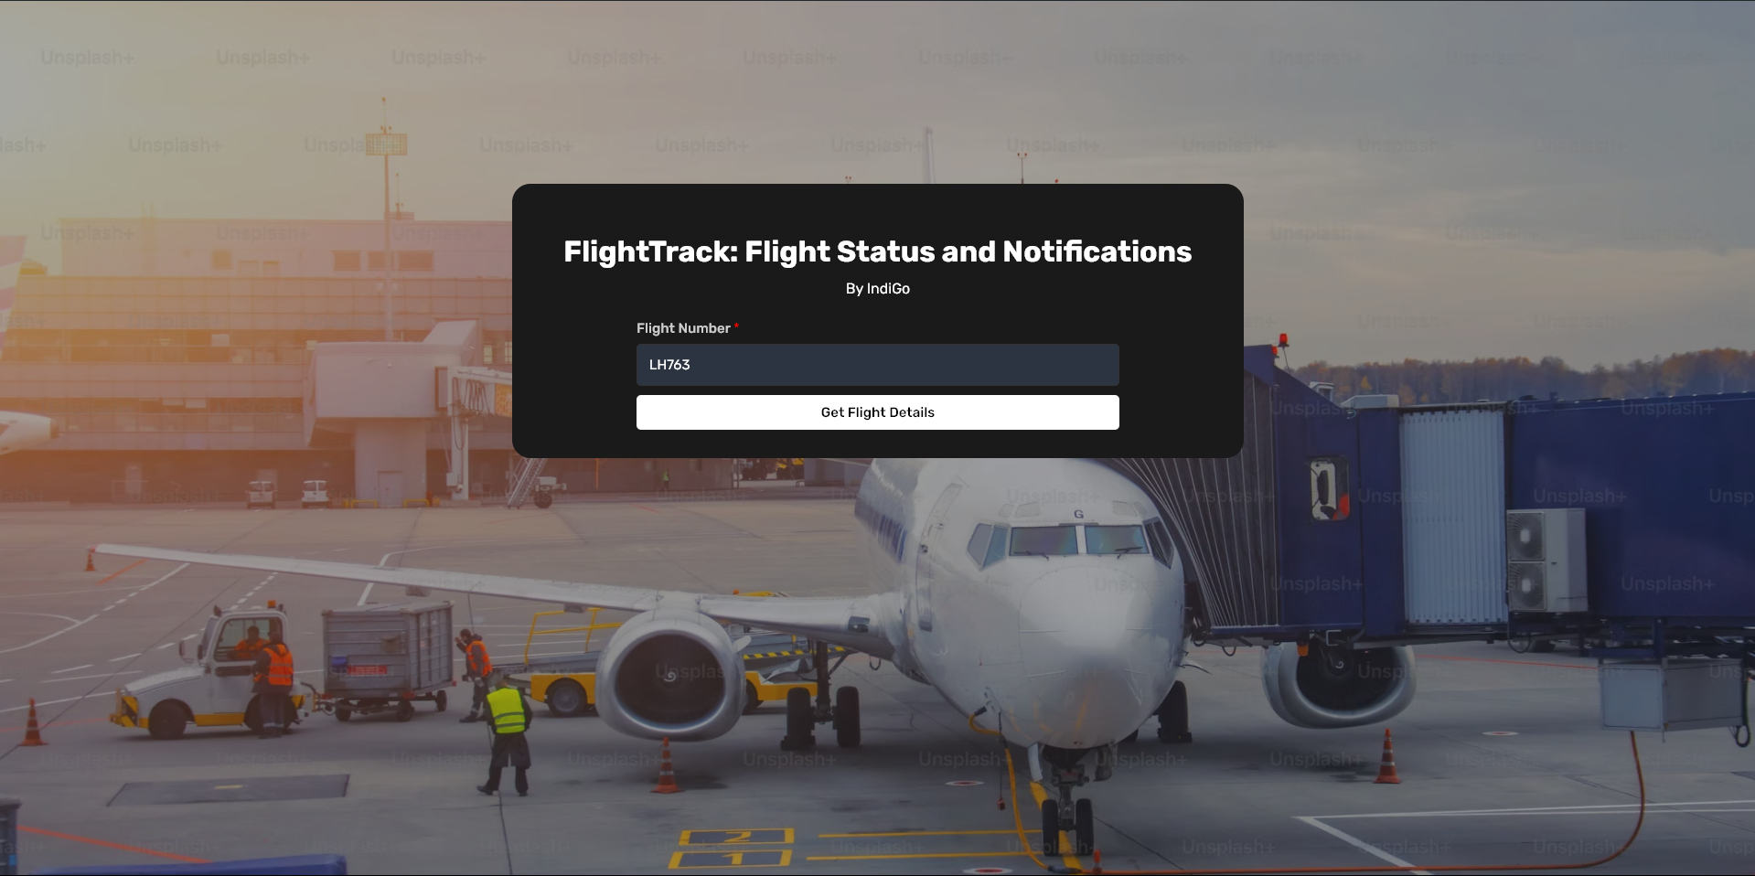
FLIGHTTRACK SCREENSHOTS
2. FILLING FLIGHT NUMBER IN FORM
Users input their flight number to retrieve detailed flight information.

Slide 8
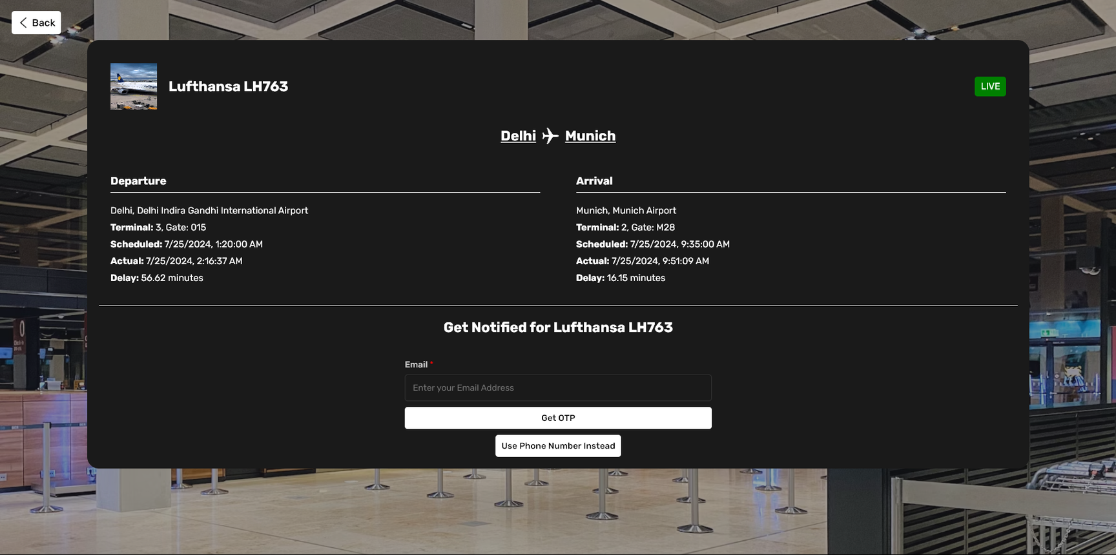
FLIGHTTRACK SCREENSHOTS
3. FLIGHT DETAILS DISPLAY
Displays comprehensive flight details including status, terminal, gate, and delay information

Slide 9
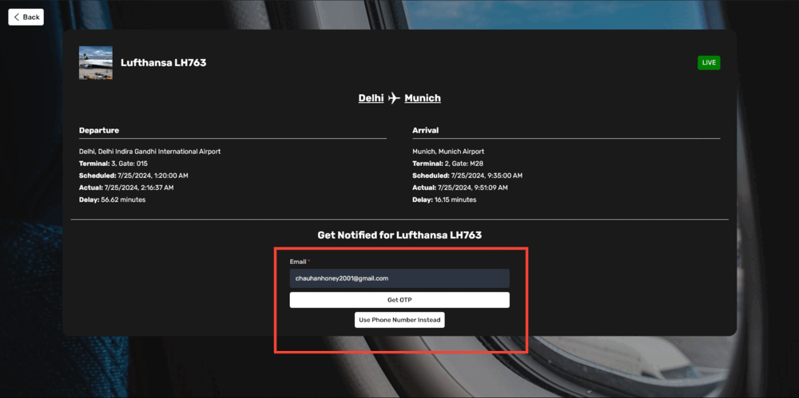
FLIGHTTRACK SCREENSHOTS
4. SUBSCRIBING FOR EMAIL NOTIFICATIONS
Users can enter their email to receive notifications about their flight status.

Slide 10
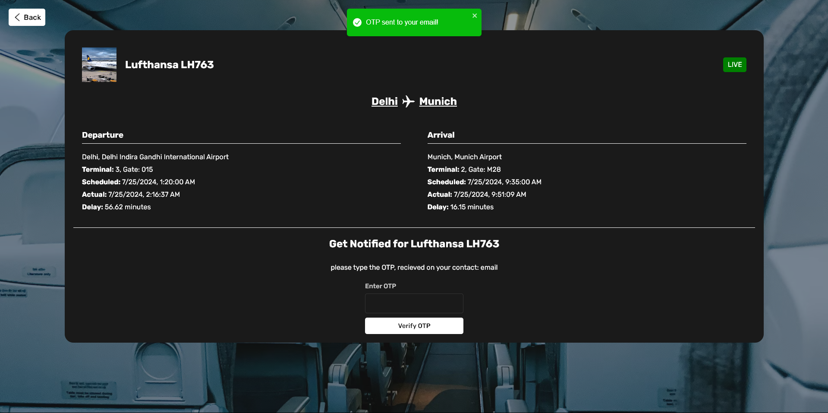
FLIGHTTRACK SCREENSHOTS
5. OTP SENT TO EMAIL/PHONE
An OTP is sent to the user's email or phone number for verification

Slide 11
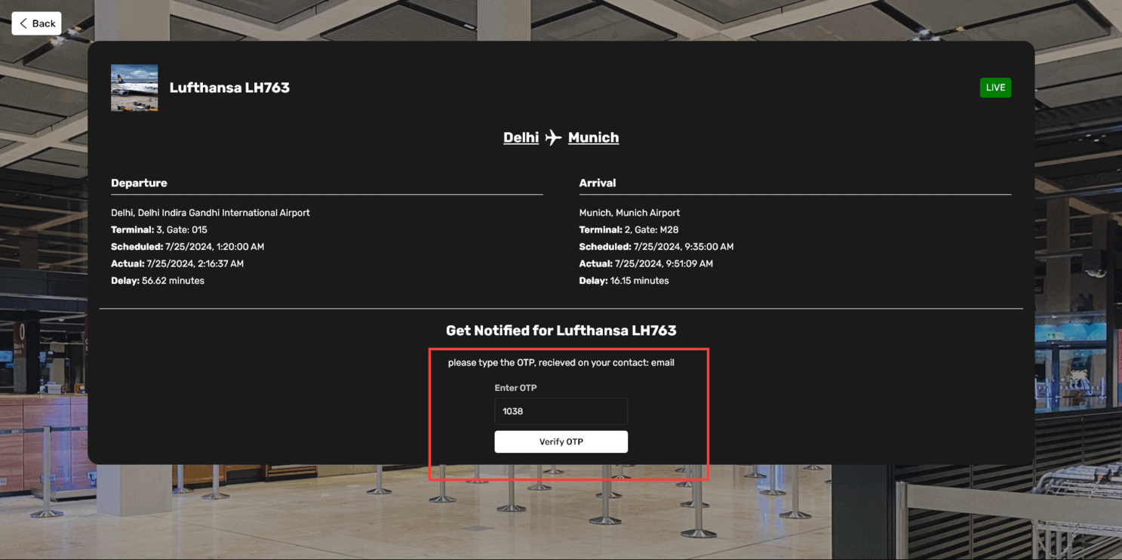
FLIGHTTRACK SCREENSHOTS
6. FILLING OTP FOR VERIFICATION
User enters the received OTP to verify their email or phone number.

Slide 12
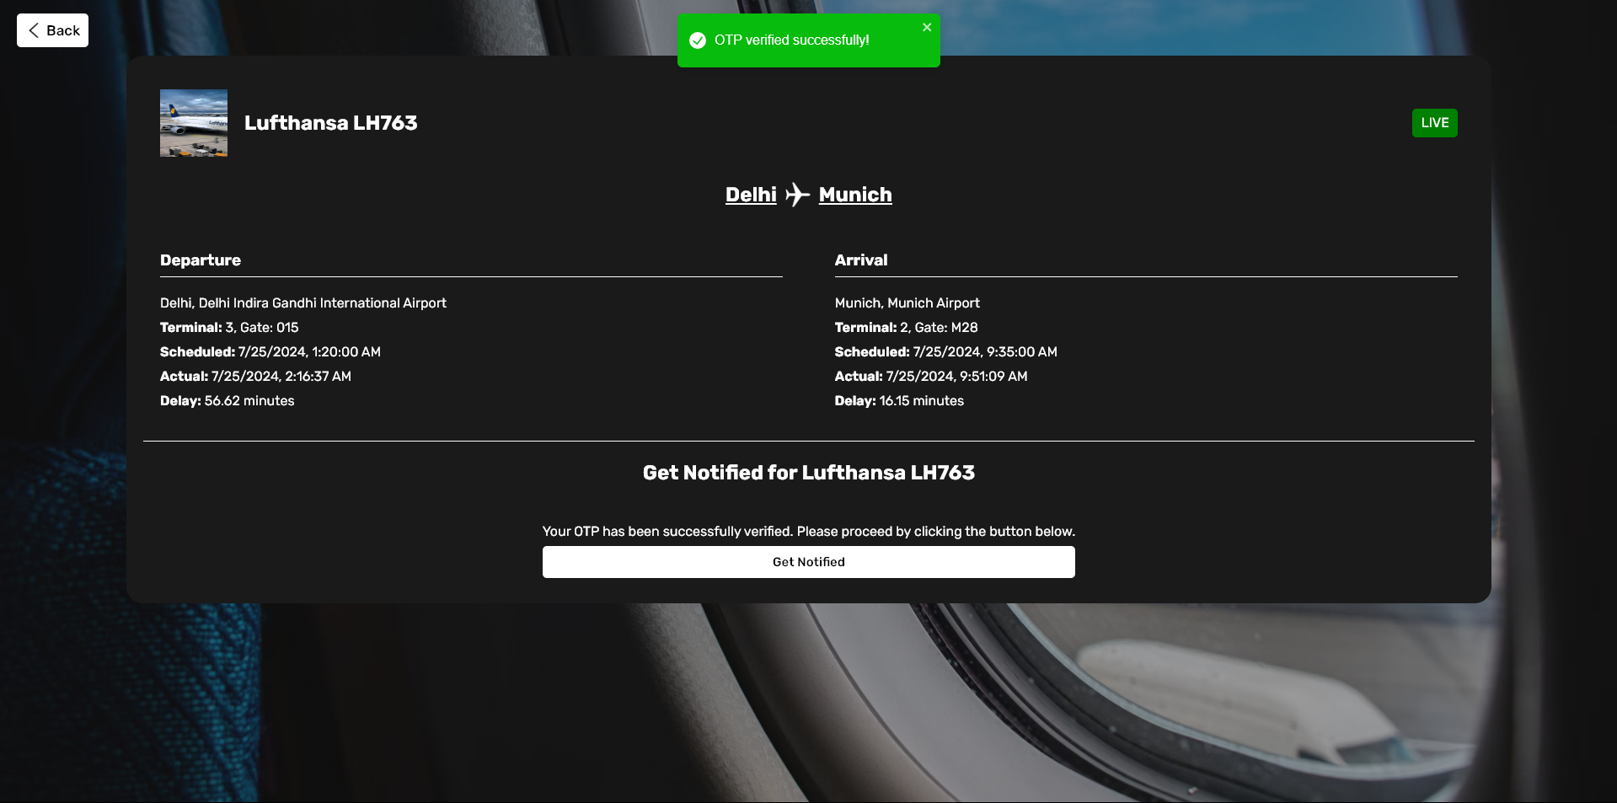
FLIGHTTRACK SCREENSHOTS
7. SUCCESS OTP NOTIFICATION
Notification indicating successful OTP verification and subscription

Slide 13
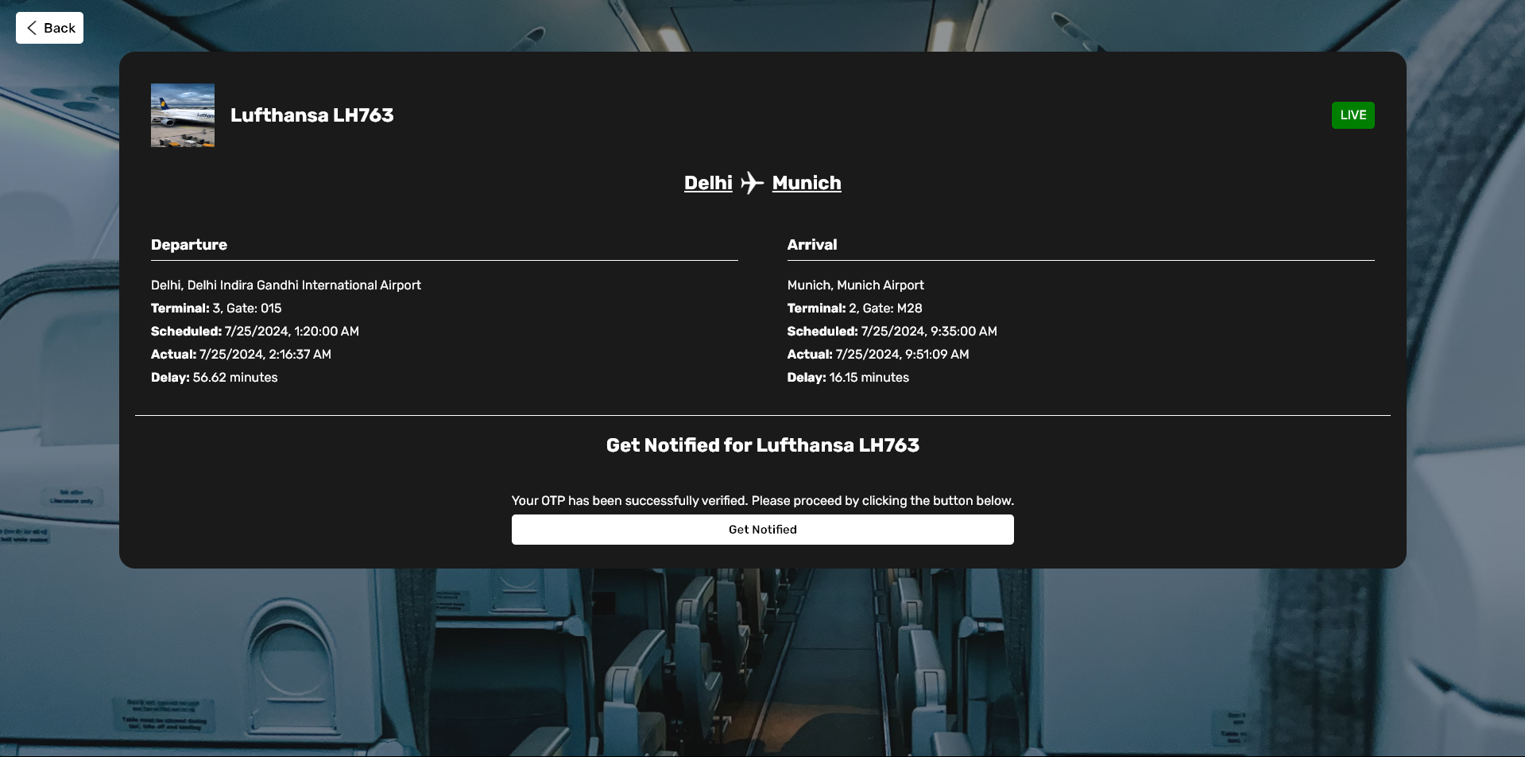
FLIGHTTRACK SCREENSHOTS
8. USER CONFIRMATION FOR UPDATES
User confirmation page indicating successful subscription for flight updates

Slide 14
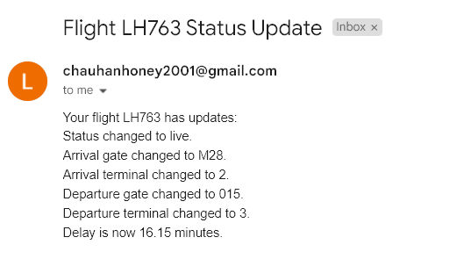
FLIGHTTRACK SCREENSHOTS
9. UPDATE NOTIFICATION ON EMAIL
Example of an email notification sent to users about their flight status updates,

Slide 15
CHALLENGES AND SOLUTIONS
There are 3 major challenges I faced while developing this application, are as follows:
REAL-TIME UPDATES AND NOTIFICATIONS
SCALABILITY OF THE BACKEND
SECURITY MEASURES (OTP VERIFICATION)
Issues
Ensuring timely and accurate updates for users
Handling increased user traffic and ensuring performance
Preventing spam and ensuring genuine user registrations
Solutions
Integrated the Flightera API for real-time data and used APScheduler to check flight statuses every 10 minutes in a free tier account.
Designed a modular architecture with Flask and MongoDB to efficiently manage and scale the backend
Implemented OTP verification via email and SMS to authenticate users before subscribing them to notifications
Further Solutions
Better API can be used which triggers whenever an update is made in a flight status and whosever user have subscribed for the flights can be alerted to increase performance
Cost efficient and Scalable backend can be developed using various cloud servers such as monolithic and serverless
reCAPTCHA integration can be done to stop DDOS attacks

Slide 16
FUTURE IMPROVEMENTS
There are 3 major challenges I faced while developing this application, are as follows:
01
Filtering Options
Implement advanced filtering options for users to customize notifications.
02
Multilingual Support
Add multi-language support to cater to a global audience.
Backend Optimization
03
Deploy backend services on these robust cloud infrastructures to improve scalability such as AWS, Azure and Google Cloud Provider.
04
Backend Optimization
Integrate with additional flight data providers for enhanced reliability.

Slide 17
CONCLUSION
Recap the Main Points of the Project
FlightTrack: A comprehensive real-time flight tracking and notification system.
Technology Stack: Utilized React for frontend, Flask for backend, and MongoDB for data storage.
Core Features: Real-time updates, push notifications, and OTP verification for secure user registration.
The Impact and Usefulness of the System
Timely and Accurate Updates: Ensures users are always informed about their flight statuses.
Enhanced User Experience: Notifications via email and SMS provide convenience and peace of mind.
Secure and Scalable: OTP verification prevents spam, and the architecture supports growth and scalability.
Thank you for your time and attention!
I appreciate the opportunity to present this project and am grateful to be a part of Hack to Hire 2024.

